Slide 1
Bayesian Hierarchical Modelling of Helium Signatures in Red Giant Stars
Daniel Williams
Partner: Joshua Cardrick
Supervisor: Guy Davies
Notes:
For those who don’t know my name etc…
Aim to give a overview of project so far.

Slide 2
Introduction
Helium Enrichment HBM
Project Overview & Motivation
Theory
Asteroseismology
Helium Glitch
Data Source
Methods
HBM / Stan
Modelling the Sun
Current Progress
Conclusion

Slide 3
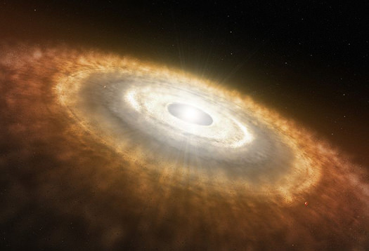
The Unknown Quantity?
Helium Enrichment HBM
He is second most abundant element
No existing laws to describe (spread of) enrichment in stars
Cannot be measured via traditional optical means
Techniques using asteroseismology offer a new tool to investigate abundance
Artists’ Impression of a protoplanetary disk – Credit: The Universe Today, https://www.universetoday.com/38118/how-was-the-solar-system-formed/
Notes:
WHY is this project important:
Lack of existing knowledge
No enrichment laws (even for spread of He)
Can use novel statistical methods to reduce err.
Impact on solar evolution models

Slide 4
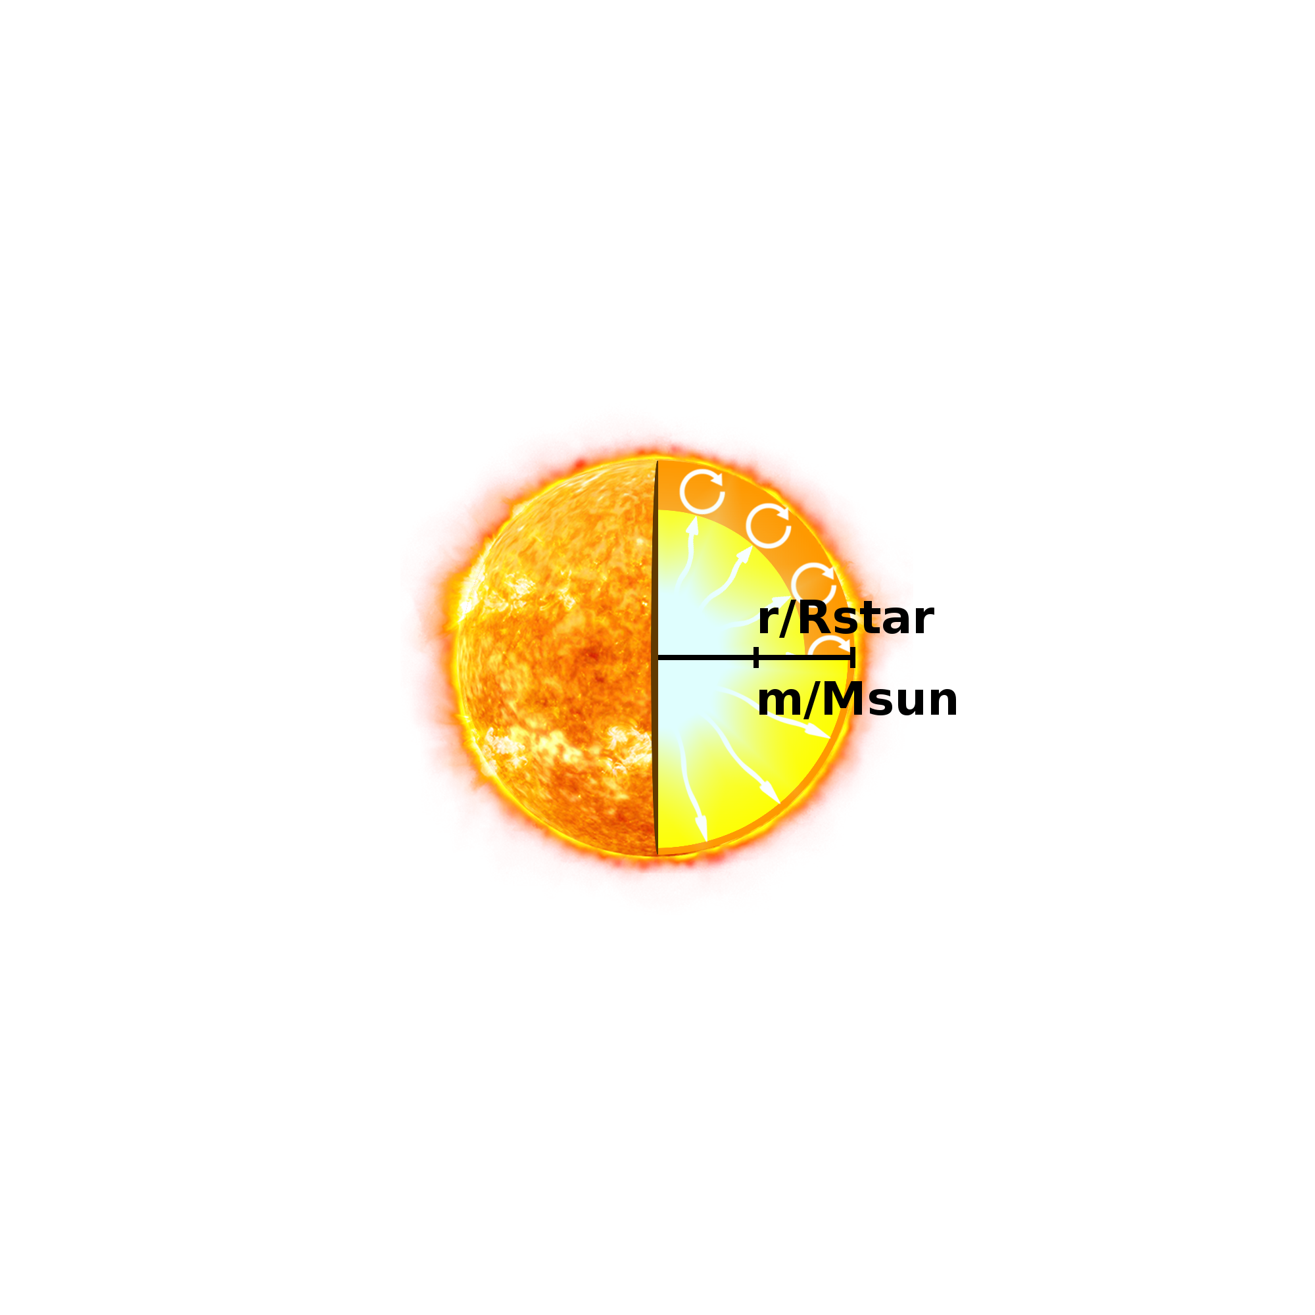

Asteroseismology
Helium Enrichment HBM
Stars are oscillators containing trapped sound
Measured using doppler shift or brightness change (photometry)
Main types of oscillations:
Pressure Waves (p-mode)
Gravity Waves (g-mode)
Mixed Modes
Applicable to solar-like stars (includes Red Giants)
Probes interior properties of stars
Interiors of a Main Sequence and RGB star – Credit: Diego Bossini
Notes:
Analogy to musical instrument
Sun like oscillators – refer to figures on RHS and compare
How measurements are taken, missions such as TESS, GAIA and PLATO in future
Types of oscillations & their causes
Different modes can provide us information on particular regions

Slide 5
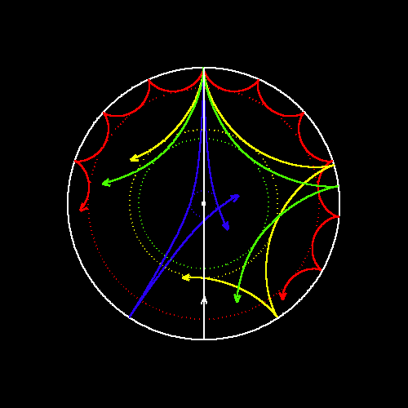
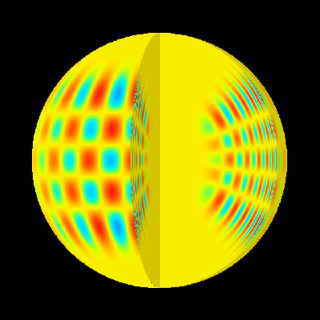
Asteroseismology
Helium Enrichment HBM
Waves provide information on the regions they pass through
Sensitivity to local environment influenced by wave node/antinodes
Propagation of different pressure modes – Credit: http://soi.stanford.edu/press/agu05-98/background.html
Oscillations of a high order pressure mode – Credit: http://soi.stanford.edu/results/heliowhat.html
Notes:
Highlight features of images
Lower angular degree, deeper penetration
Higher radial degrees recorded
Sensitivity changes according to acoustic radius, ability to see useful features

Slide 6
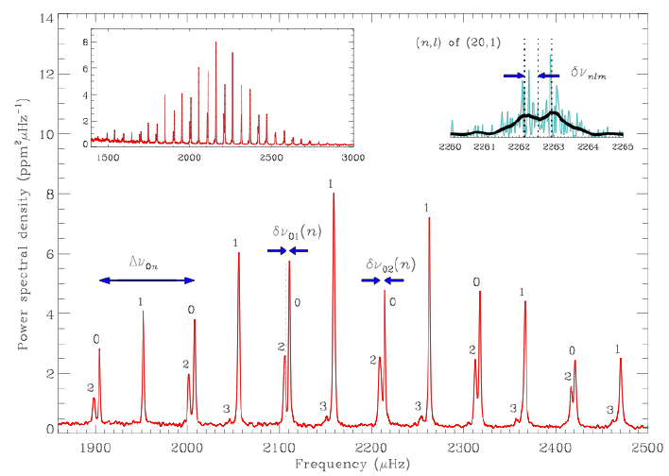
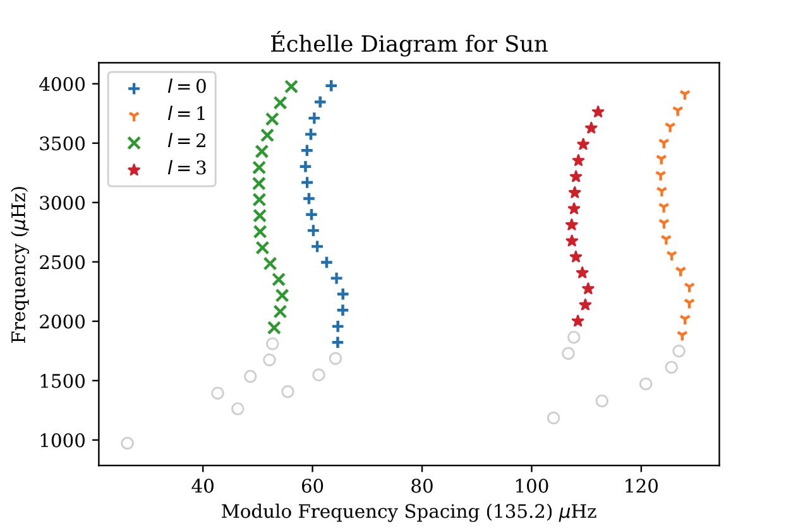
Asteroseismology
Helium Enrichment HBM
Power frequency spectrum for the star 16 Cygni A– Credit: Bill Chaplin
Échelle diagram for the Sun, own work
Notes:
Explain figures:
UNITS!
Prominent features
Link to Échelle of sun, showing curvature and ‘wiggles’
Link to Glitch

Slide 7
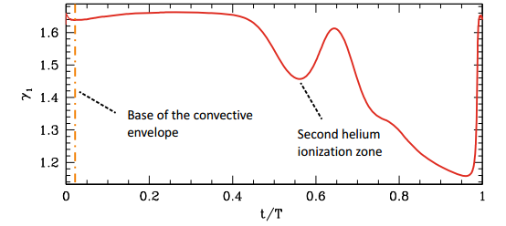
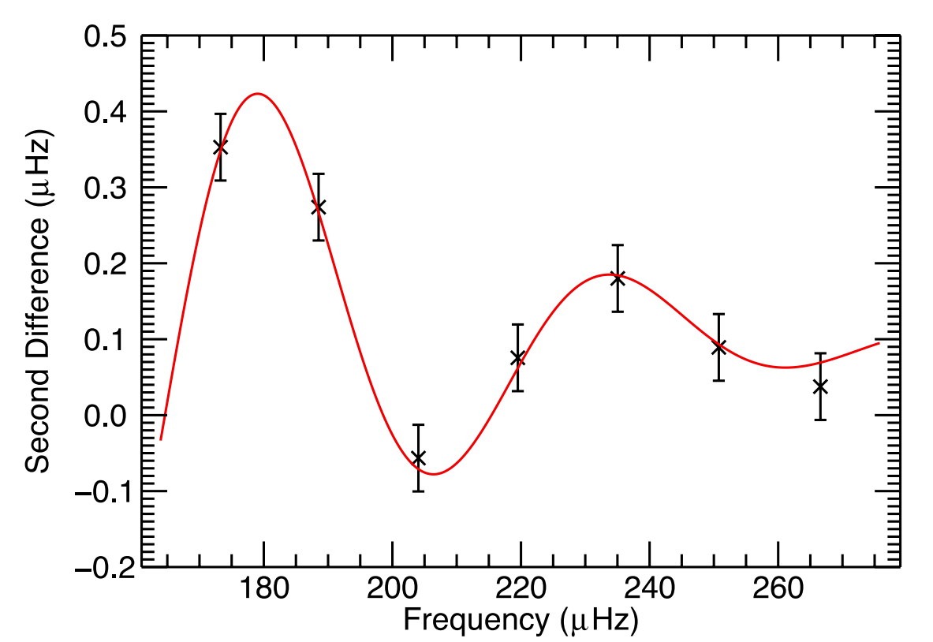
The Helium Glitch
Helium Enrichment HBM
Change in adiabatic exponent (γ₁) → sound speed (c_{s}) → properties of certain modes
Occurs in two regions:
Helium II ionisation
Base of convective zone (BCZ)
Decaying oscillatory form – higher radial modes become desensitised to glitch
Provides constraint on the type of stars used
Value of adiabatic exponent γ1 with varying acoustic depth within a RGB star. Credit: A. Miglio et al. (2010)
Recorded Helium glitch for a RGB star using l=0 modes. Credit: A.M.Broomhall et al. (2013)
Notes:
Crux of our analysis
Describe formation and impact on data
Why does the signal decay??

Slide 8
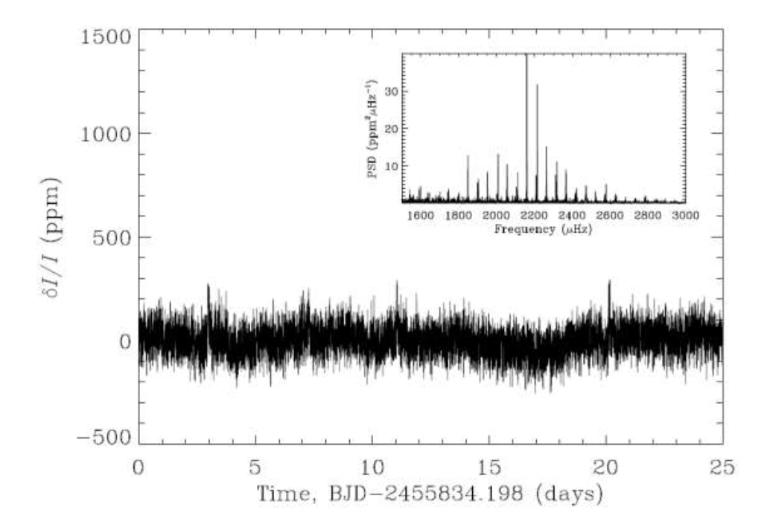
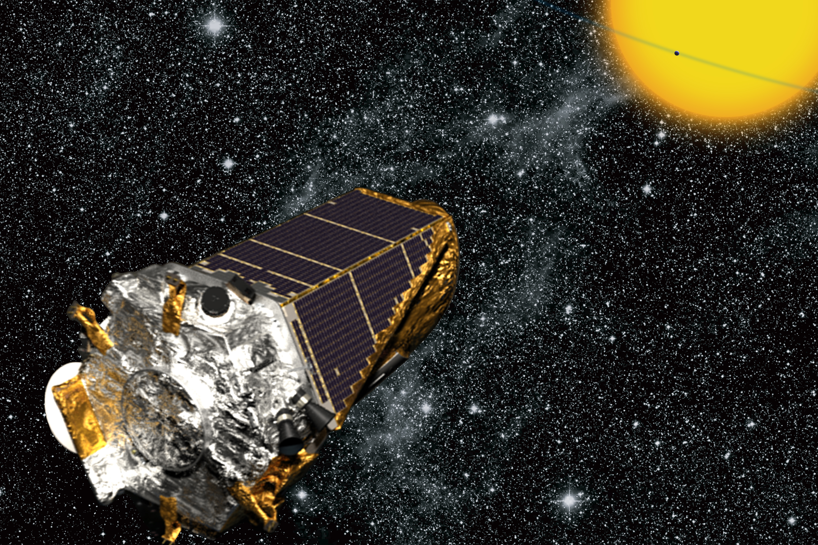
Data Source
Helium Enrichment HBM
Kepler Telescope
Launched 2009
Repurposed K2 mission 2014
Planet-finding telescope
Operational until last year
1000 RGB stars available for use
Stars approx. 1-1.5 solar masses
Kepler lightcurve of the main-sequence star 16 Cyg A- Credit: Bill Chaplin
Artist’s Impression of Kepler - Credit: https://www.newswise.com/articles/kepler-spacecraft-helps-astronomers-find-tiny-planet-beyond-our-solar-system
Notes:
Talk through summary of Kepler mission
Why certain stars are used – reasoning!

Slide 9
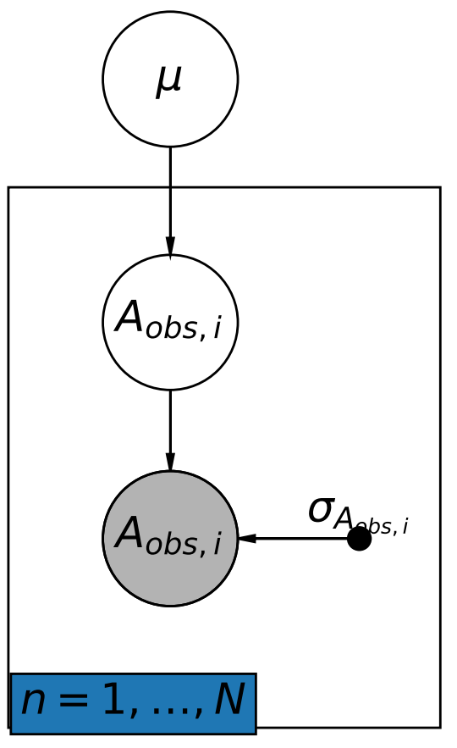
Analysing Data
Helium Enrichment HBM
Using Hierarchical Bayesian Models (HBM)
Leverage population statistics to reduce uncertainties
Computationally advantageous for numerous variables
Implemented using ‘Stan’
Cyclic Diagram as an extremely simplified representation of our model. Own work.
Notes:
Why we use HBM:
“Leverage the power of the ensemble in order to reduce uncertainty”
Computationally efficient for many variables
GIVE ANALOGY TO PARTY
DESCRIBE CYCLIC DIAGRAM
We will be using STAN – no u-turn sampler

Slide 10
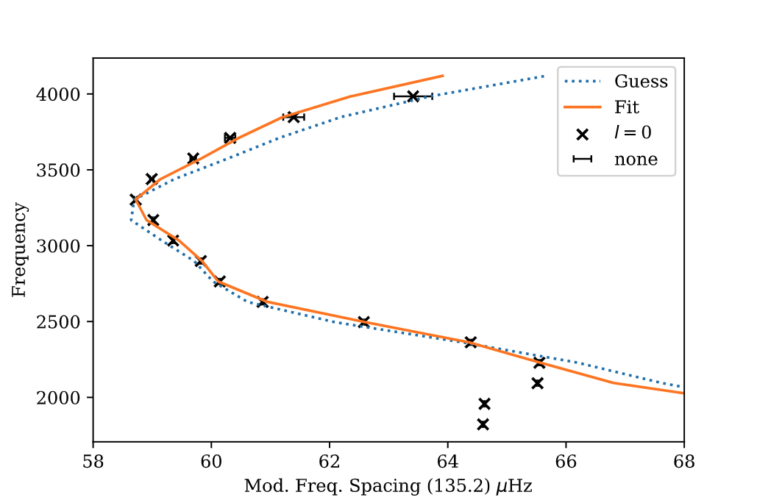
Modelling the Sun
Helium Enrichment HBM
Fitting l=0 modes for the Sun using Stan. Own work.
Notes:
In order to develop our skills and provide a proof of concept
Data from BiSON
Initial guess using a python function , trial and error taking long time
Pass through stan to see instant improvement

Slide 11
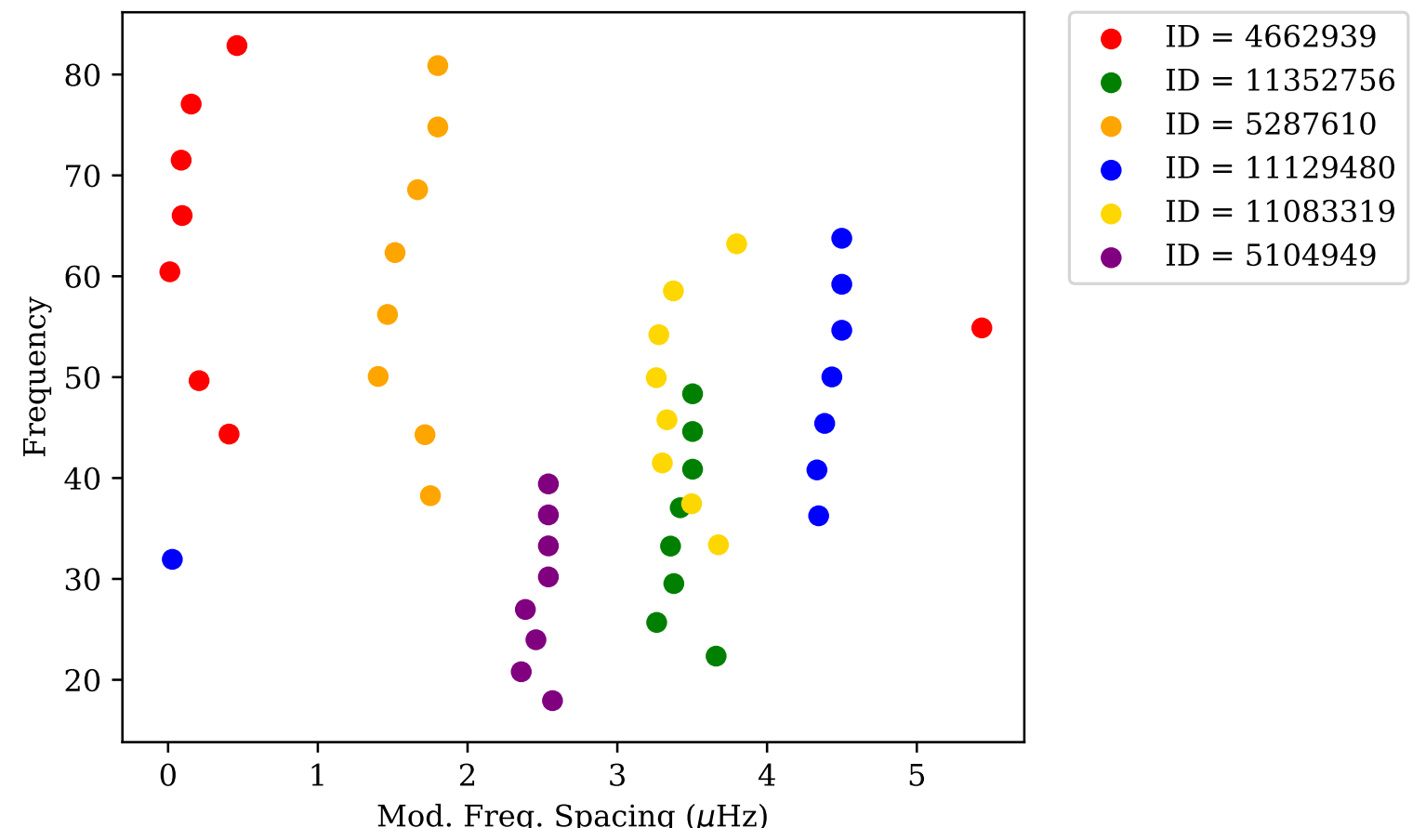
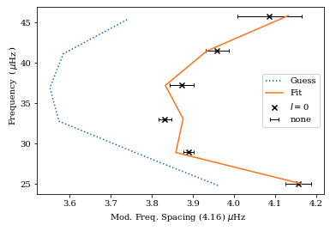
Current Progress
Helium Enrichment HBM
Fitting RGB modes. Own work.
First look at applying HBM to multiple stars. Own work.
Notes:
LHS: Modelling an RGB star before priors were improved (WHY?)
RHS: Current situation, barebones working HBM that is able to process multiple stars at once. Fully hierarchical.
Convergence of model not finessed so [REVEAL seizure plot] fits are currently rather poor
Link into improvements

Slide 12
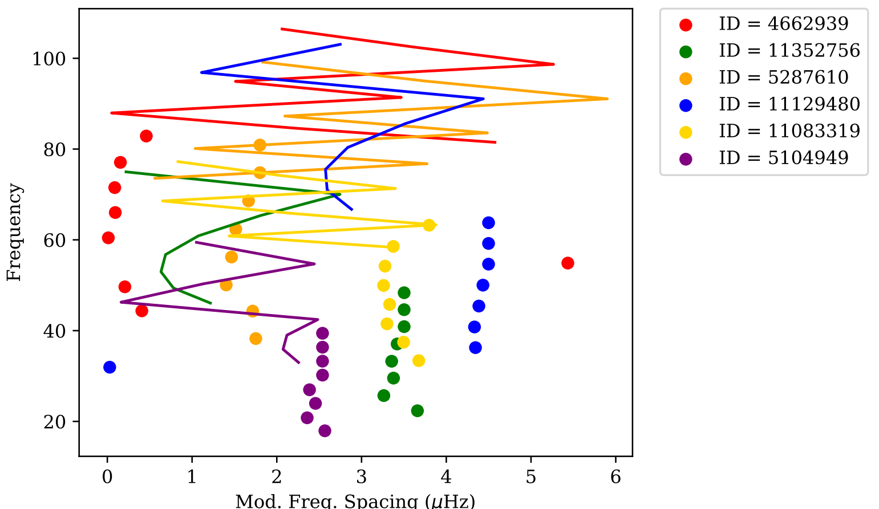
Current Progress
Helium Enrichment HBM
Fitting RGB modes. Own work.
First look at applying HBM to multiple stars. Own work.

Slide 13
Aims & Conclusion
Finesse convergence of model to reproduce mode frequencies accurately.
Develop existing HBM to deal with larger datasets.
Gain an estimate on the spread of helium enrichment throughout stars.
Notes:
Improve convergence
Apply to large samples of RGB stars
Close up; thank you and open to questions.

Slide 14
Helium Enrichment HBM

